Slide 1
Long-lead Forecasting of
Extreme Precipitation:
Alexander Burke
Divya Bajaj
Yu-Ju Chien
Oleksandr Pimenov
source code link

Slide 2
Data Pre-Processing
Constructed data samples in proper format which can be used by different machine learning algorithms.
For each day where one sample has 10 days of data, we created an empty data frame to be used as a main container.
Then, for each year 1980 - 2011, read one file from raw data and dropped first 4 columns. This frame was then added to the bottom of the main container.
Also, since we are shifting consequent days UP we need to delete day number of top rows and 9 - day number of bottom rows (as there are 0-9 days).

Slide 3
Data Pre-Processing
For improved performance it is better to take only needed rows since we are putting these frames side by side and shifting each one row up (like a staircase). At last
At last, we wrote one meteo variable for one day in a separate file.
90 files of features were produced. Each file represents a column and one file for labels.
These experimental samples (features and labels) were further used for feature selection.

Slide 4
Scalable and Accurate OnLine Approach (SAOLA)
Problem: The number of features for the data is way too large to reasonably or meaningfully train a classifier. What approach should we use to cut down on the number of features?
For this project we were asked to use SAOLA: Scalable and Accurate OnLine Approach for feature selection.
Results: 14-18 features on our own preprocessed data set (depending on correlation formula used)
2-4 features on given data set (depending on SAOLA implementation 1 or 2)

Slide 5
Highlighting the relevant features on a map
Using SOALA Algorithm, we were able to produce the relevant features, their corresponding location and day.
The location id was used to find longitude and latitude which depicts where that location is exactly on the world map. This was to plot the specific feature of that location on a specific day.
We used simple library gmplot. Gmplot generates an html with a google map and markers in specified locations.

Slide 6
Correlation Functions
Thinking about the Pearson correlation function, we found out that pandas.corr function has two more correlation functions as an optional arguments to corr function.
We have decided to use all three correlation functions and compare the results.
The results are as follows: Pearson -> 15 features, Kendall -> 18 features, Spearman -> 19 features.

Slide 7
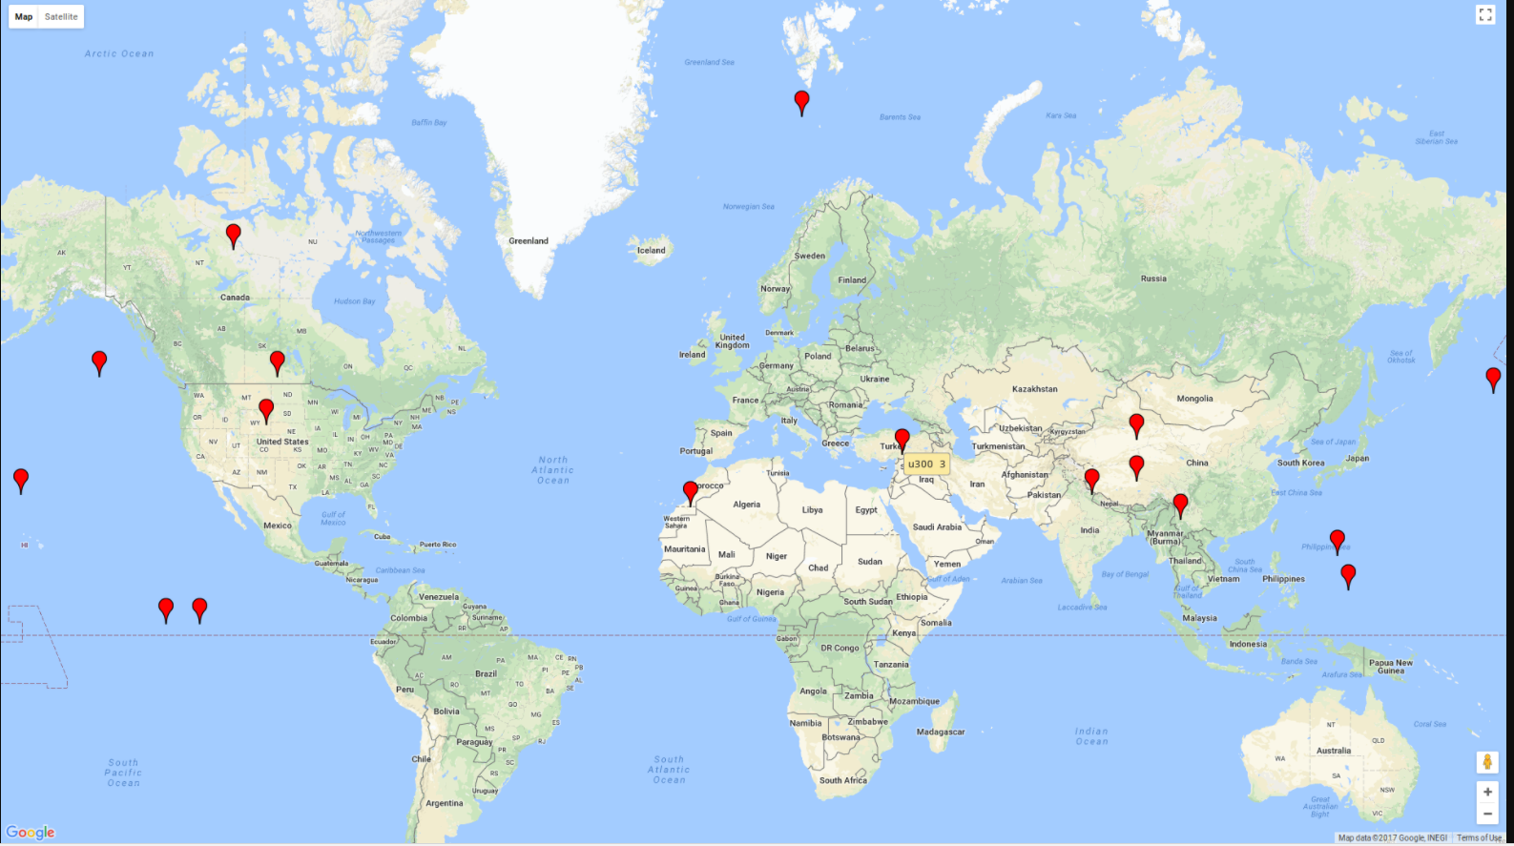
Kendall correlation function

Slide 8
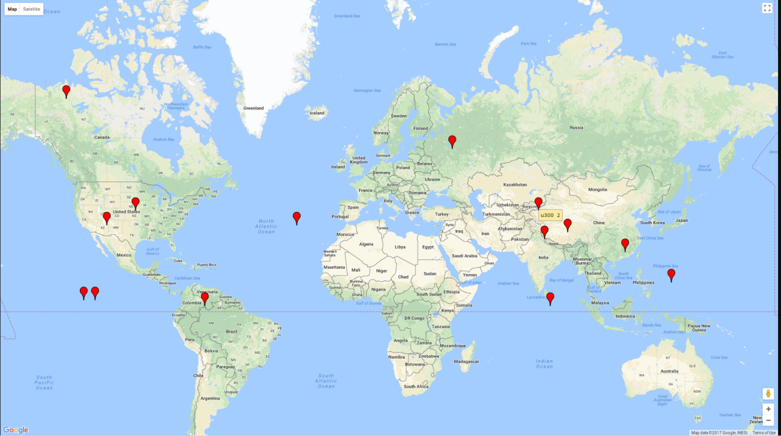
Pearson correlation function

Slide 9
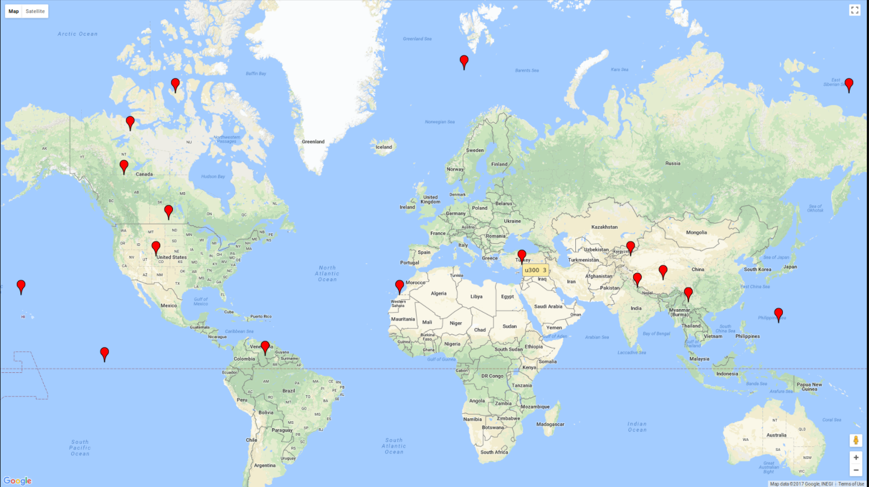
Spearman correlation function

Slide 10
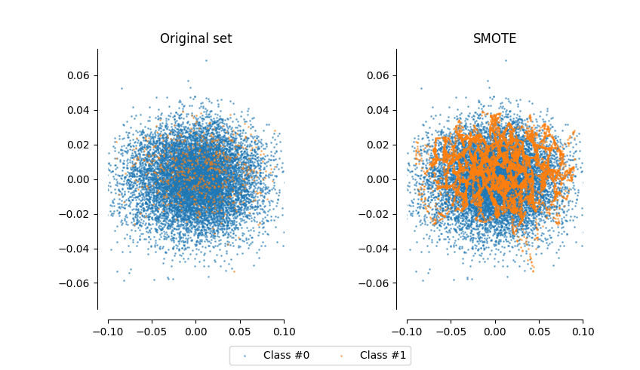
Unbalanced Data: Undersampling & Oversampling

Slide 11
Undersampling & Oversampling
Definitions from cited source:
Oversampling : With oversampling, data from the minority class (in our case, class label “1”) is artificially reproduced so it has greater representation in the dataset
Undersampling : With undersampling, data labeled with the majority class is removed to obtain a balanced dataset
Oversampling is best for smaller datasets while undersampling is better for larger datasets. (Brownlee)
Source: https://machinelearningmastery.com/tactics-to-combat-imbalanced-classes-in-your-machine-learning-dataset/

Slide 12
Undersampling & Oversampling
We used imbalanced learn, a library of undersampling and oversampling algorithms to deal with this imbalanced data
https://github.com/scikit-learn-contrib/imbalanced-learn

Slide 13
Undersampling & Oversampling
Our dataset was right on the borderline between what was recommended as being “large” and “small,” (~10,000 samples) but we had better results with oversampling and combinations of oversampling and undersampling than with any of the undersampling algorithms alone.
We only resampled the training data with its target after doing the suggested split by years. Our trained classifiers then made predictions on the unmodified set of test features. This was based off of the recommendation of the cited source, Brownlee.
Source: https://machinelearningmastery.com/tactics-to-combat-imbalanced-classes-in-your-machine-learning-dataset/

Slide 14
Classification Model
KNN
Naïve Bayes
SVM
Random Forests
Multilayer Perceptron

Slide 15
Confusion Matrix
KNN
Predicted
0 1
Actual 0 1684 0
1 119 0
Naïve Bayes
Predicted
0 1
Actual 0 1056 628
1 9 110

Slide 16
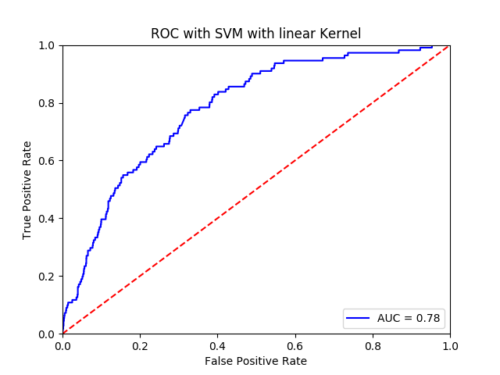
Alexander Burke – SVM Classifier SVM – Random Over Sampler
54% accuracy on test data
Predicted
0 1
Actual 0 1204 955
1 16 95

Slide 17
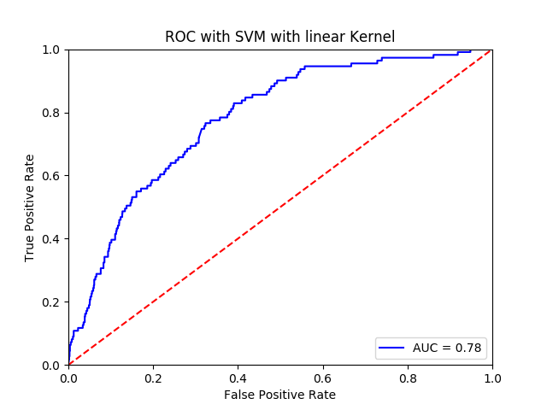
SVM – SMOTE
57% accuracy on test data
Predicted
0 1
Actual 0 1194 955
1 16 95

Slide 18

SVM – ADASYN
57% accuracy on test data
Predicted
0 1
Actual 0 1183 966
1 16 95

Slide 19
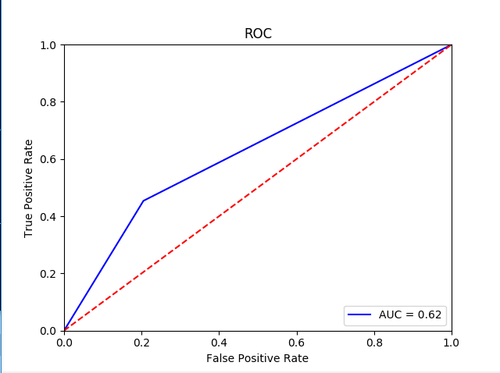
ROC curve for Random forest using SMOTE + ENN
​
78% accuracy on test data​
Predicted​
0 1​
Actual 0 1354 330
1 66 53​
​

Slide 20
Alex Pimenov MLP intro
MLP (multilayer perceptron) is a class of feedforward (does not have cycles) artificial neural network.
It has multiple layers and non-linear activation.
It can distinguish data that is not linearly separable.

Slide 21




ANN parameters
Tried activation functions:
sigmoid function, hyperbolic tangent,
rectified linear unit function
f(x) = max(0, x)
Tried hidden layer sizes configurations:
(1,) (4,2) (4,8,4) (16,256,16,4) (16,256,256,16,4)
Other configurations: learning rate, max iterations, tol

Slide 22
Accuracy is great
(16, 256, 16, 4)
95% accuracy on test data
Predicted
0 1
Actual 0 2142 0
1 118 0
(4, 2)
75% accuracy on test data
Predicted
0 1
Actual 0 1602 540
1 36 82

Slide 23
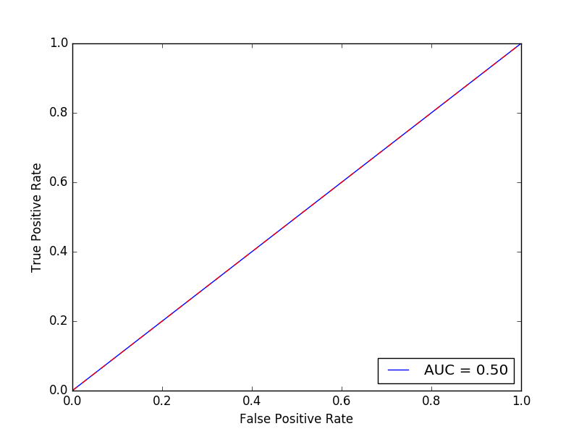
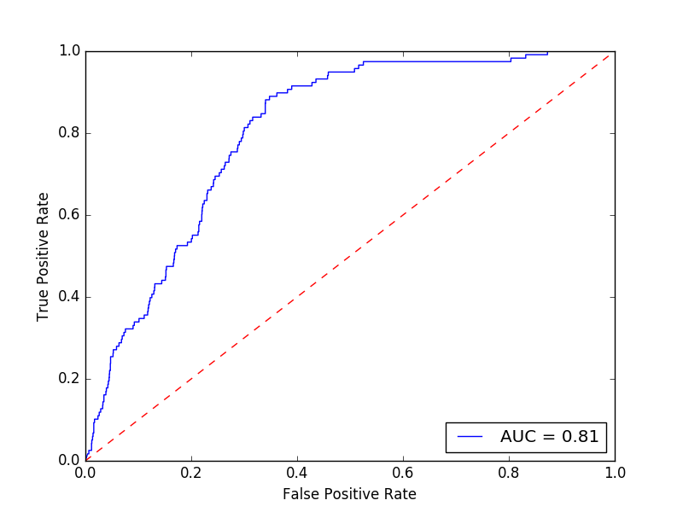
ROC curves much better
95% accuracy
75% accuracy

Slide 24
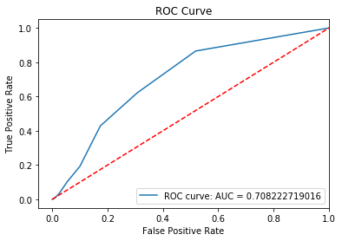
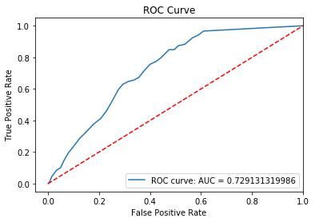
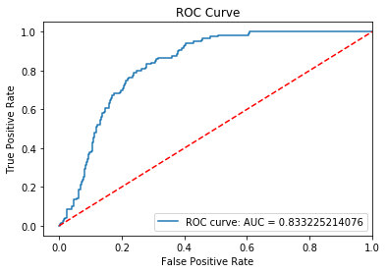
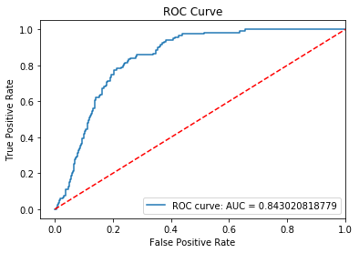
ROC Curves Summary
KNN - Imbalanced | KNN - Balanced | Naïve Bayes - Imbalanced | Naïve Bayes - Balanced | SVM – Random over sampler
SVM - SMOTE | SVM - ADASYN | Random Forest – SMOTE + ENN | MLP - Imbalanced | MLP - Balanced

